Slide 1
Software Project Planning

Slide 2
Software Project Planning
After the finalization of SRS, we would like to estimate size, cost and development time of the project. Also, in many cases, customer may like to know the cost and development time even prior to finalization of the SRS.

Slide 3
Software Project Planning
In order to conduct a successful software project, we must understand:
Scope of work to be done
The risk to be incurred
The resources required
The task to be accomplished
The cost to be expended
The schedule to be followed

Slide 4
Software Project Planning
Software planning begins before technical work starts, continues as the software evolves from concept to reality, and culminates only when the software is retired.
Size estimation
Cost estimation
Development time
Resources requirements
Fig. : Activities during Software Project Planning
Project scheduling

Slide 5
Software Project Planning
Fig. : Function for sorting an array
Size Estimation
Lines of Code (LOC)
If LOC is simply a count of the number of lines then figure shown contains 18 LOC .
When comments and blank lines are ignored, the program in figure 2 shown below contains 17 LOC.
1. | int. sort (int x[ ], int n)
2. | {
3. | int i, j, save, im1;
4. | /*This function sorts array x in ascending order */
5. | If (n<2) return 1;
6. | for (i=2; i<=n; i++)
7. | {
8. | im1=i-1;
9. | for (j=1; j<=im; j++)
10. | if (x[i] < x[j])
11. | {
12. | save = x[i];
13. | x[i] = x[j];
14. | x[j] = save;
15. | }
16. | }
17. | return 0;
18. | }

Slide 6
Software Project Planning
The only executable statements in figure shown above are in lines 5-17 leading to a count of13.
The differences in the counts are 18 to 17 to 13.
Potential for major discrepancies for large programs with many comments or programs written in language that allow a large number of descriptive but non-executable statement.
Conte has defined lines of code as:
“A line of code is any line of program text that is not a comment or blank line, regardless of the number of statements or fragments of statements on the line. This specifically includes all lines containing program header, declaration, and executable and non-executable
statements”.
This is the predominant definition for lines of code used by researchers. By this definition, figure shown above has 17 LOC.

Slide 7
Software Project Planning
Function Count
Alan Albrecht while working for IBM, recognized the problem in size measurement in the 1970s, and developed a technique (which he called Function Point Analysis), which appeared to be a solution to the size measurement problem.
This approach deals the software in terms of number of functions it delivers to the user and not by its size in terms of LOC and files.

Slide 8
Software Project Planning
The principle of Albrecht’s function point analysis (FPA) is that a system is decomposed into functional units.
Inputs
Outputs
Enquiries
:
:
:
information entering the system information leaving the system
requests for instant access to information
information held within the system
information held by other system that is used by the system being analyzed.
Internal logical files
:
External interface files
:

Slide 9
Software Project Planning
Albrecht’s analysis decomposes the system into FPA functional units
User
Inquiries
Other applications
Inputs
ILF
User
EIF
Outputs
System
ILF: Internal logical files
EIF: External interfaces
Fig. 3: FPAs functional units

Slide 10
Software Project Planning
The five functional units are divided in two categories:
(i) Data function types
Internal Logical Files (ILF): A user identifiable group of logical related data or control information maintained within the system.
External Interface files (EIF): A user identifiable group of logically related data or control information referenced by the system, but maintained within another system. This means that EIF counted for one system, may be an ILF in another system.

Slide 11
Software Project Planning
Transactional function types
External Input (EI): An EI processes data or control information that comes from outside the system. The EI is an elementary process, which is the smallest unit of activity that is meaningful to the end user in the business.
External Output (EO): An EO is an elementary process that generates data or control information to be sent outside the system.
External Inquiry (EQ): An EQ is an elementary process that is made up to an input-output combination that results in data retrieval.

Slide 12
Software Project Planning
Special features of function point analysis
Independent of the language, tools, or methodologies used for implementation; i.e. programming languages, DBMS etc
Can be estimated from requirement specification or design specification, thus making it possible to estimate development efforts in early phases of development.
Are directly linked to the statement of requirements; any change of requirements can easily be followed by a re-estimate.
Based on the system user’s external view of the system, non-technical users of the software system have a better understanding of what function points are measuring.

Slide 13
Software Project Planning
Counting function points
Functional Units | Weighting factors
 | Low | Average | High
External Inputs (EI) | 3 | 4 | 6
External Output (EO) | 4 | 5 | 7
External Inquiries (EQ) | 3 | 4 | 6
Internal logical files (ILF) | 7 | 10 | 15
External Interface files (EIF) | 5 | 7 | 10
Table 1 : Predefined values for weighting factors for calculating Unadjusted Function Point (UFP) Count

Slide 14
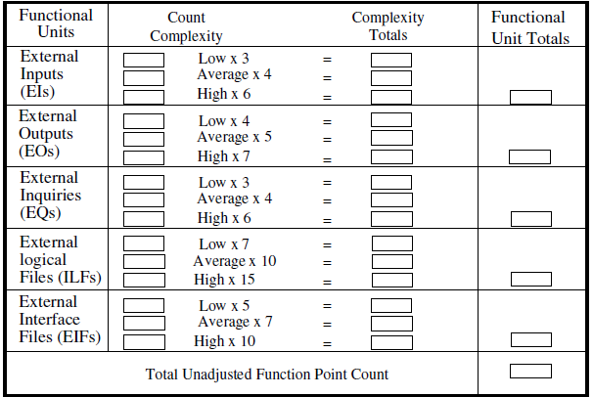
Software Project Planning
Table to calculate UFP

Slide 15
Software Project Planning
The procedure for the calculation of UFP in mathematical form
5 3
UFP = ∑∑ Z_{ij} w_{ij}
i=1 J =1
Where i indicate the row and j indicates the column of Table 1
W_{ij} : It is the entry of the i^{th} row and j^{th} column of the table 1
Zij : It is the count of the number of functional units of Type i that have been classified as having the complexity corresponding to column j.

Slide 16
Software Project Planning
Adjusted Function points are calculated as below:
FP = UFP * CAF
Where CAF is complexity adjustment factor and is equal to
CAF = [0.65 +0.01 x Σf_{i}]
The F_{i} (i=1 to 14) are the degrees of influence and are based on responses to questions provided in the next table.

Slide 17
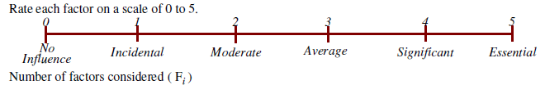
Software Project Planning
Number of factors considered ( F_{i} )
Does the system require reliable backup and recovery ?
Is data communication required ?
Are there distributed processing functions ?
Is performance critical ?
Will the system run in an existing heavily utilized operational environment ?
Does the system require on line data entry ?
Does the on line data entry require the input transaction to be built over multiple screens or operations ?
Are the master files updated on line ?
Is the inputs, outputs, files, or inquiries complex ?
Is the internal processing complex ?
Is the code designed to be reusable ?
Are conversion and installation included in the design ?
Is the system designed for multiple installations in different organizations ?
Is the application designed to facilitate change and ease of use by the user ?

Slide 18
Software Project Planning
Functions points may compute the following important metrics:
Productivity Quality | = = | FP / persons-months Defects / FP
Cost | = | Rupees / FP
Documentation | = | Pages of documentation per FP
These metrics are controversial and are not universally acceptable. An ISO standard for function point method is also being developed.

Slide 19
Software Project Planning
Example: Consider a project with the following functional units:
Number of user inputs = 50
Number of user outputs = 40
Number of user enquiries = 35
Number of user files = 06
Number of external interfaces = 04
Assume all complexity adjustment factors and weighting factors are average. Compute the function points for the project.

Slide 20
Software Project Planning
Example: An application has the following:
10 low external inputs, 12 high external outputs, 20 low
internal logical files, 15 high external interface files, 12
average external inquiries, and a value of complexity
adjustment factor of 1.10.
What are the unadjusted and adjusted function point counts ?

Slide 21
Software Project Planning
Example:
Consider a project with the following parameters.
External Inputs:
10 with low complexity (b)15 with average complexity
(c) 17 with high complexity
External Outputs:
6 with low complexity (b)13 with high complexity
External Inquiries:
3 with low complexity
4 with average complexity
2 high complexity

Slide 22
Software Project Planning
Internal logical files:
2 with average complexity (b)1 with high complexity
External Interface files:
9 with low complexity
In addition to above, system requires
Significant data communication
Performance is very critical
Designed code may be moderately reusable
System is not designed for multiple installation in different organizations.
Other complexity adjustment factors are treated as average. Compute the function points for the project.

